Slide 1
Bohr’s Atomic Model

Slide 3
J J Thomson’s Atomic Model

Slide 4
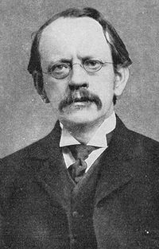
J J Thomson’s Model
Discovery of Electron Plum pudding model Discovery of isotopes Mass spectrometer invention First m/e measurement Proposed first waveguide Thomson scattering Thomson problem Coining term 'delta ray’ Coining term 'epsilon radiation’ Thomson (unit)

Slide 5
At that time before 1904
Atoms are neutrally charged
Negatively charged particles called ELECTRONS are present in an atom.

Slide 6
Postulates
An ATOM is a sphere of positive charge with electrons present inside the sphere.
The positive and negative charge are equal in number so, atom is electrically neutral.
He visualized all the positive charge of the atom as being spread out uniformly throughout a sphere of atomic dimensions
Model is like Spherical Plum pudding or like Watermelon

Slide 7
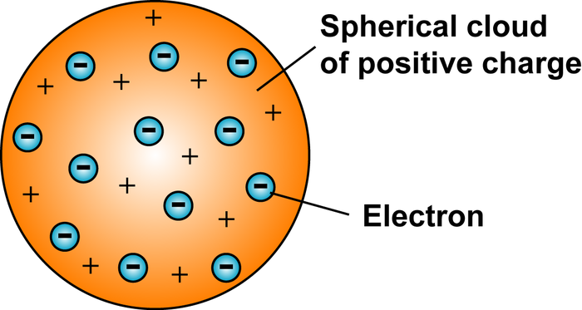
Plum Pudding Model

Slide 8
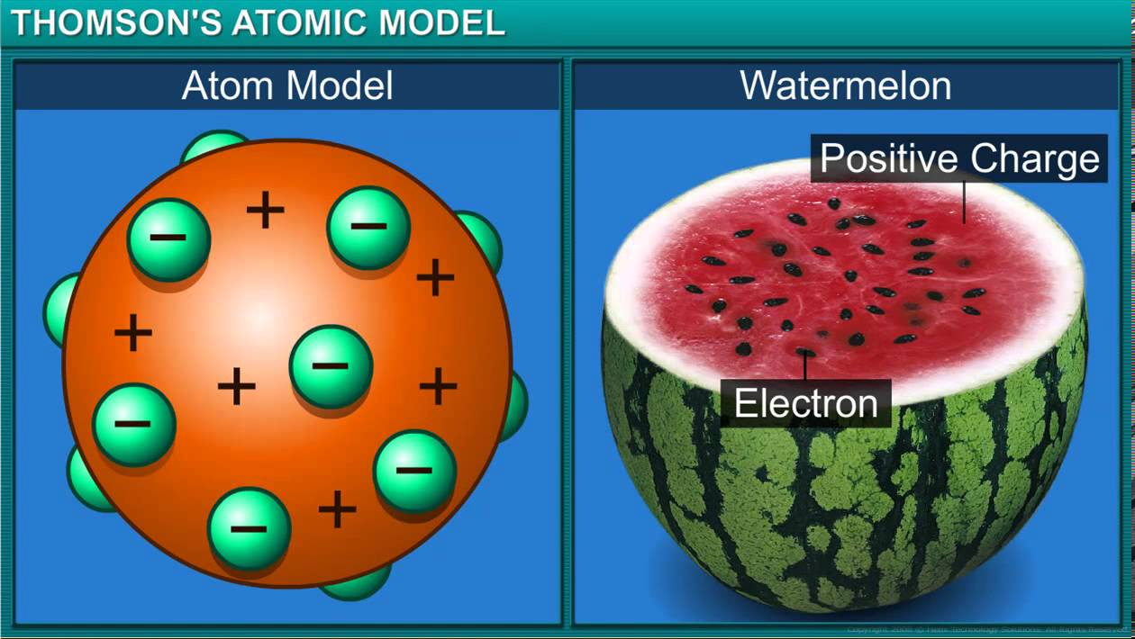

Slide 9
Plum pudding?
Positively charged
porridge
Negatively charged
raisins (plums)
+
+
+
+
-
-
-
+
+
+
+
+
-
-
-
+
+
+
+
-
-
+
+
-
+
10⁻¹⁰m

Slide 10
Drawbacks
Failed to explain how positive charge holds on electrons inside the atom.
Failed to explain ATOMS stability.
The theory does not talk about NUCLEUS.
Unable to explain the results of Rutherford Scattering experiment.

Slide 11
Conclusion
Even though it has some drawbacks, It provided the base for several other ATOMIC STRUCTURES models.

Slide 12
Rutherford’s Atomic Model

Slide 13
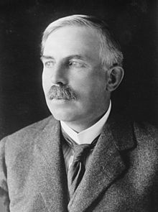
Ernest Rutherford
Discovery of Alpha and Beta radioactivity.
Discovery of atomic nucleus (Rutherford model)
Rutherford scattering
Rutherford backscattering spectroscopy
Discovery of proton
Rutherford (unit)
Coining the term 'artificial disintegration'

Slide 14
Rutherford Gold Foil Experiment

Slide 15
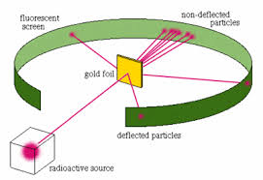
Gold Foil Experiment

Slide 16
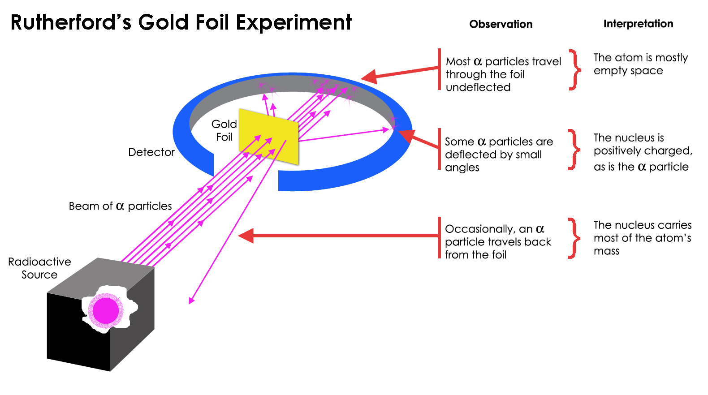
Gold Foil Experiment

Slide 17
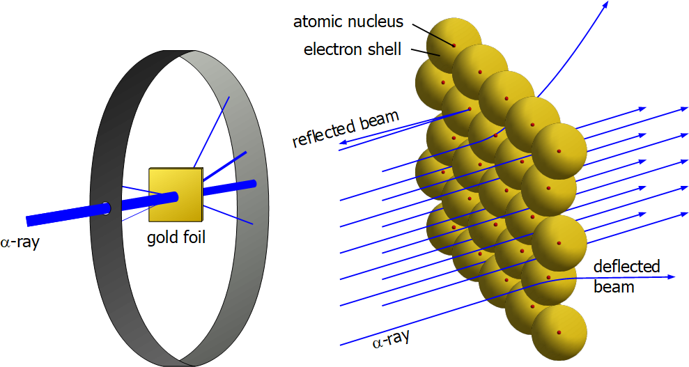
Gold Foil Experiment

Slide 18
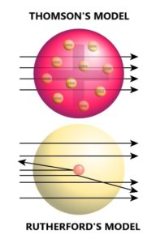
Thomson’s Vs Rutherford’s

Slide 19
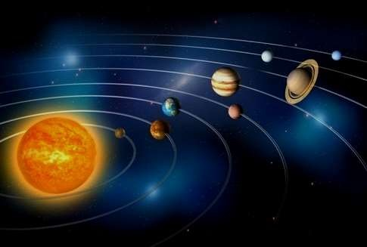
After the Gold Foil Experiment Rutherford’s proposed the Planetary Model of Atom.
Just like the solar system, the Nucleus lies in the center of the atom and electron revolves around it in their orbits

Slide 20
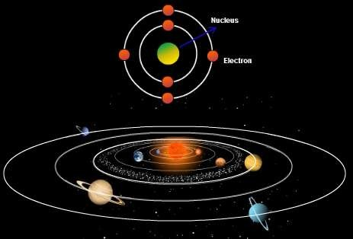

Slide 21
Conclusions of Gold Foil Experiment
Since most of the α-particles passed through the foil undeflected, most of the space in the atom is empty.
The deflection of a few positively charged α-particles must be due to the enormous repulsive force.
This suggests that the positive charge is not uniformly spread throughout the atom as Thomson had proposed.
The positive charge must be concentrated in a very small volume to deflect the positively charged α-particles.
Rutherford’s calculations show that the volume of the nucleus is very small compared to the total volume of the atom and the radius of an atom is about 10⁻¹⁰m, while that of the nucleus is 10⁻¹⁵m.

Slide 22
Postulates
An atom is composed of positively charged particles.
Majority of the mass of an atom was concentrated in a very small region called NUCLEUS.
Atoms nucleus is surrounded by negatively charged particles called ELECTRONS.
The electrons revolve around the nucleus in a fixed circular path at very high speed. These fixed circular paths were termed as “ORBITS”.

Slide 23
Postulates Contd…
An atom has no net charge, or they are electrically neutral.
Electrons and Nucleus are held strongly by electrostatic force of attraction.
The size of the nucleus of an atom is very small in comparison to the total size of an atom.

Slide 24
Drawbacks
Rutherford’s model was unable to explain the stability of an atom.
Electrons revolve at a very high speed around a nucleus of an atom in a fixed orbit i.e. they are accelerated.
As per Maxwell Electromagnetic theory, accelerated charged particles release electromagnetic radiations. Therefore, electrons revolving around the nucleus will release electromagnetic radiation.

Slide 25
Drawbacks
Due to continuous emission of radiation, the electron should loose energy and should fall into nucleus. So, atom should collapse.
As per Maxwell’s Electromagnetic theory Rutherford’s model atom will collapse with in a time of 10⁻⁸ seconds.
Did not explain arrangement of electrons in the orbit.

Slide 26

But!!
The Revolution of the electron in a circular orbit is not expected to be stable.
-
+
-

Slide 27

Any particle in a circular orbit would undergo acceleration.
During acceleration, charged particles would radiate energy (hν).
-
+
-

Slide 28

Thus, the revolving electron would lose energy and finally fall into the nucleus. If this were so, the atom should be highly unstable and hence matter would not exist in the form that we know
.
+
-

Slide 29
As the electron spiral inwards, their angular velocities and frequency would change continuously and so will the frequency of the energy emitted.
Thus, they would emit a continuous spectrum, in contrast to the line spectrum actually observed

Slide 30
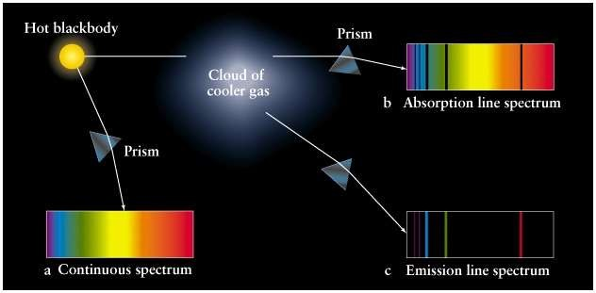

Slide 31
Bohr’s Atomic Model

Slide 32
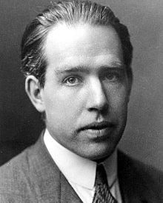
Niels Bohr
Bohr magneton
Bohr model
Bohr radius
Bohr–Einstein debates
Bohr–Kramers–Slater theory
Bohr–van Leeuwen theorem
Bohr–Sommerfeld theory
Complementarity
Copenhagen interpretation

Slide 33
Bohr’s Model
Bohr’s Atomic Model
Nucleus
Electron
Orbit
Energy Levels

Slide 34
Postulates
Electrons revolve around the nucleus in a fixed circular path termed “orbits” or “shells” or “energy level.” The orbits are termed as “stationary orbit.”
Every circular orbit will have a certain amount of fixed energy and these circular orbits were termed orbital shells.
The electrons will not radiate energy if they continue to revolve around the nucleus in the fixed orbital shells.
The change in energy occurs when the electrons jump from one energy level to other.

Slide 35
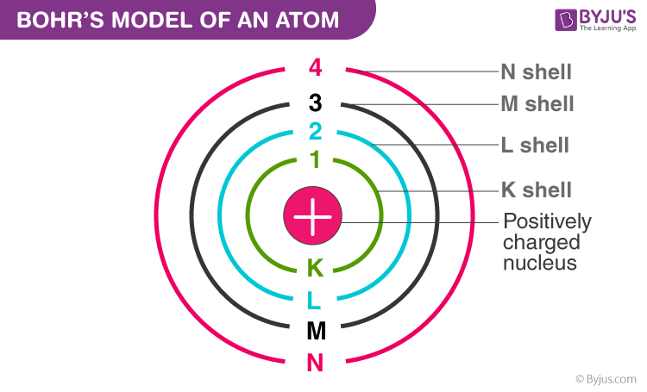

Slide 36
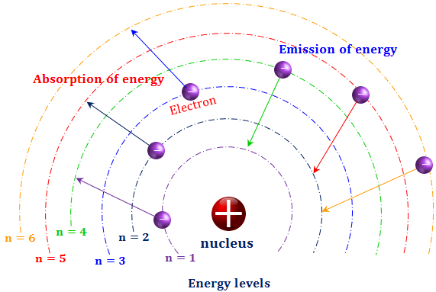

Slide 37
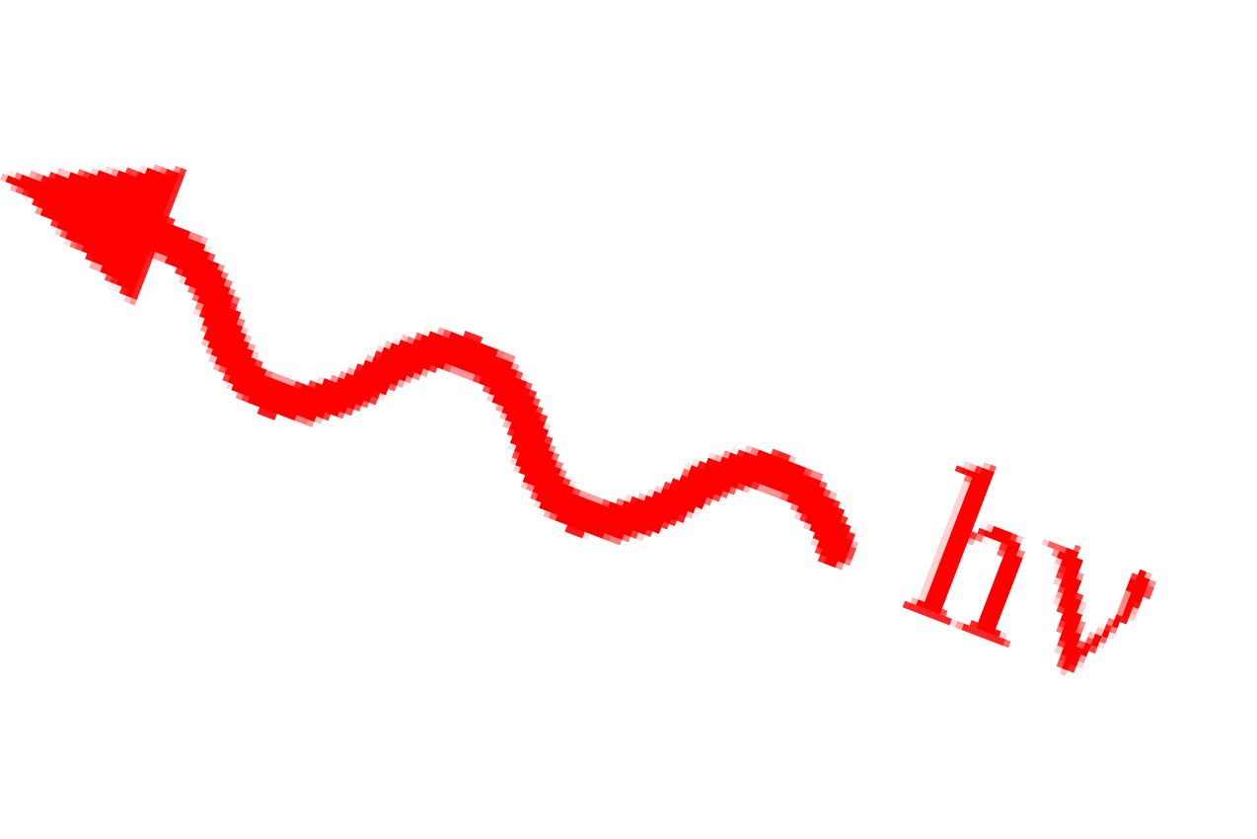
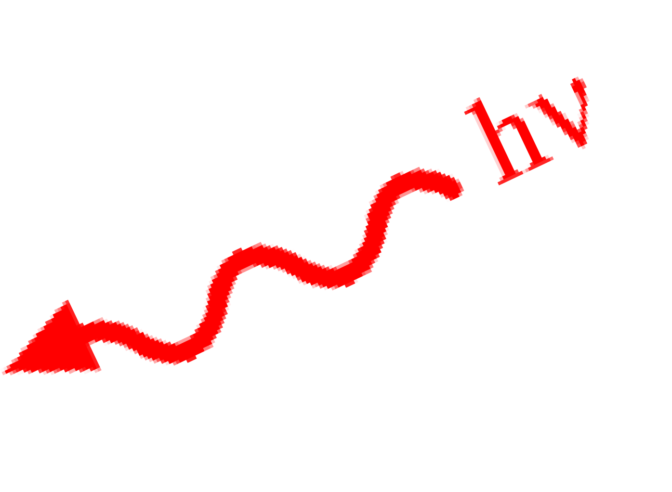
-
n=2
e
-
+hν
(Energy )
-hν
(Energy )
+
n=1
e

Slide 38
Bohr’s atomic model

Slide 39
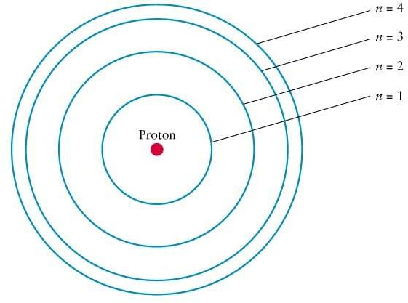
The angular momentum (mvr) of an electron is equal to nh/2π.
The angular momentum of an orbit depends upon its quantum number
(n) and it is integral multiple of the factor h/2π
i.e. mvr = nh/2 π
Where,
n = 1, 2, 3, 4,….

Slide 40
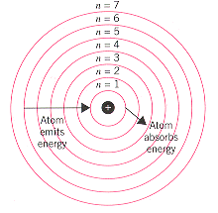
Arrangement of Electrons
1st orbit (n=1) is represented as K shell and it can hold up to 2 electrons.
2nd orbit (n=2) is represented as L shell and it can hold up to 8 electrons.
3rd orbit (n=3) is represented as M shell and it can contain up to 18 electrons.
4th orbit (n=4) is represented as N Shell and it can contain maximum 32 electrons.

Slide 41
Drawbacks of Bohr’s Atomic Model

Slide 42
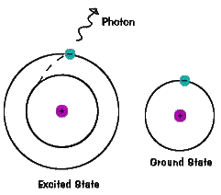
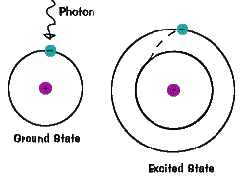
According to Bohr, the radiation results when an electron jumps from one energy orbit to another energy orbit, but he did not explained how this radiation occurs.

Slide 43















Bohr’s theory successfully explained
the observed spectra for H – atom and similar ions (He⁺¹ , Li⁺² , Be⁺³ etc) but it can not explained the spectra for poly electron atoms.
+1 +2
+3
Hydrogen 1p, 1e
Helium ion
2p, 1e
Lithium Ion
3p, 1e
Beryllium Ion
4p, 1e

Slide 44
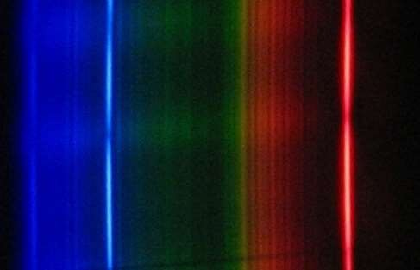
Bohr’s theory explained the existence of various lines in H-spectrum, but it predicted that only a series of lines exist. Later on it was realized that the spectral lines that had been thought to be a single line was actually a collection of several lines very close to each other.

Slide 45

If a substance which gives line emission spectrum is placed in a magnetic field, the lines of the spectrum get split up into a number of closely spaced lines. This phenomenon is known as Zeeman effect. Bohr’s theory has no explanation for this effect.

Slide 46
If a substance which gives line emission spectrum is placed in an external electric field, the lines of the spectrum get split up into a number of closely spaced lines. This phenomenon is known as Stark effect. Bohr’s theory has no explanation for this effect as well.

Slide 47
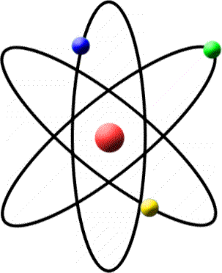
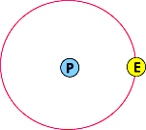
Bohr suggested circular orbits of electron around the nucleus of H – atom but later it was proved that the motion of electron is not in a single plane, but takes place in three dimensional space.

Slide 48
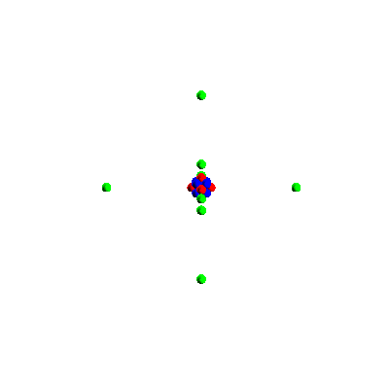

Bohr’s assumes that an electron in an atom is located at a definite distance from the nucleus and is revolving round it with definite velocity i.e. it has a fixed momentum.
This idea is not in agreement with Heisenberg’s uncertainty principle which states that it is impossible to determine the exact position and momentum of a particle simultaneously with certainty.

Slide 49
